Slide 1
VIDHYADEEP INSTITUTE OF MANAGEMENT AND TECHNOLOGY
Prepared By:
130940119111
130940119112
130940119113
Guided By :Mahesh Padia

Slide 2
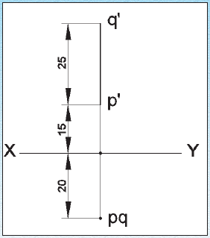
EXAMPLE PROBLEMS:-
I.DRAW THE PROJECTION OF A LINE PQ, 25 mm LONG IN THE FOLLOWING POSITIONS
Perpendicular to the H.P., 20 mm infront of V.P and its one end 15 mm above the H.P

Slide 3
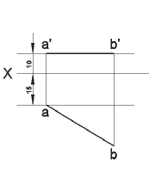
Engineering Graphics
EXAMPLE PROBLEMS:-
V.Draw the projection of a straight line AB of 40 mm length is parallel to the H.P and inclined at 30° to the V.P. its end point A is 10 mm from the H.P and 15 mm from the V.P

Slide 4
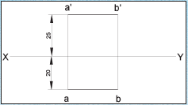
Engineering Graphics
EXAMPLE PROBLEMS:-
iii.Draw the projection of a 30 mm long AB, straight line parallel to both H.P and V.P and 25 mm above H.P and 20 mm infront of V.P

